Slide 1
Brain Tumor Detection Using CNN

Slide 2
GROUP MEMBERS
FAISAL NAWAZ KHAN (FA21-BAI-006)
USMAN YOUSAF (FA21-BAI-016)
MAHNOOR ASGHAR (FA21-BAI-037)
OBAIDULLAH (FA21-BAI-065)

Slide 3
INTRODUCTION

Slide 4
INTRODUCTION
We provide the brain tumor detection project code and dataset for you. This dataset is already divided into training and testing. The train folder contains the images which will be passed as a training dataset. The test folder contains the images which will be passed as a test dataset. Then we finally predict the result by passing an image from our testing dataset.

Slide 5
Brain Tumor
The source of brain tumors can be traced back to aberrant cells forming in the brain, some of which are precancerous, some of which are cancerous or damaging, and others which are innocuous or noncancerous.
Tumors are classified into three types: those that begin in the brain and those that are subsequent cancerous growths that can spread to different areas of the human body; in such circumstances, the carcinoma is said to have metastasized in the patient and is most lethal, with a very poor survival rate.

Slide 6
Classification of Brain Tumors
Brain tumors can be classified into three main types, firstly there are pituitary tumors secondly meningioma tumor and the third one is glioma tumor that are cancerous in nature.
The characteristics of tumors are as follows:
Majority of benign tumors are identified and diagnosed using CT and MRI brain scans
Tumors usually have a very slow rate of growth and do not spread into neighboring tissues.
It grows slowly and does not invade surrounding tissues or spread to other organs.
They can be easily seen of CT scan by identifying their patently visible edges and boundaries

Slide 7
Classification of Brain Tumors
Malignant Tumor: Malignant brain tumors are cancerous cells and often having boundaries and edges that are not easily visible or identified. With highly rapid growth rate, Malignant tumors are the most life-threatening growths due their tendency to aggressively spread and invade the surrounding tissues.
The characteristics of a malignant tumors are as follows:
Rapid development and inclination to spread to various regions of the brain and spinal cord, making them extremely deadly with a high mortality and poor survival rate.
Tumors can be graded on various levels, for instance grade 1 and 2 tumors can be either harmless or cancerous, but grade 3 and 4 are considered to be definite malignant growths.

Slide 8
PROBLEM STATEMENT

Slide 9
Motivation
Diagnosing tumors in medical imaging is time consuming due to its manual nature as it mainly relies on human ability and judgment. Specialists in this field, such as radiologists, examine images from CT scans, MRIs, and PET scans and make decisions on which treatment depends. This assiduous process takes a couple of hours to complete. Automation of the detection process helps to cut down a significant amount of time and effort needed.

Slide 10
Objective
The primary goal of this work is to create a model that can predict whether or not MRI images include cancer. We created and trained a model that could detect the tumor, presenting an efficient and effective way for assisting in the segmentation and identification of brain tumors that eliminates the need for manual labor. Finally, when we compared the outcomes of all tests, we discovered that certain models performed better in terms of accuracy and loss metrics.

Slide 11
METHODOLOGY

Slide 12
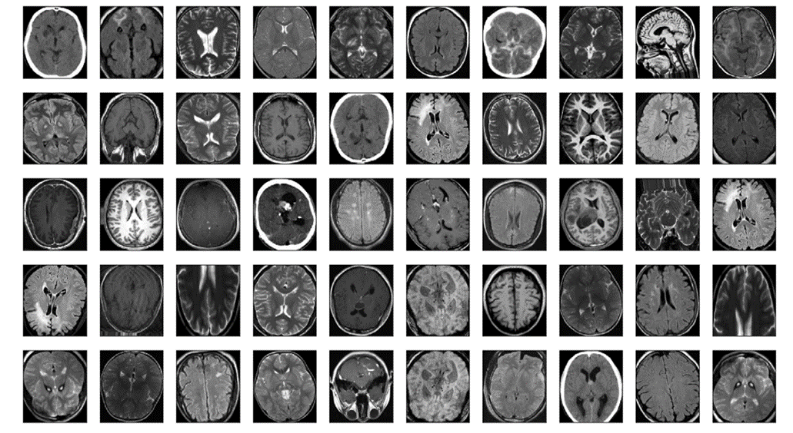
Dataset
The Database was gathered from Kaggle, named ‘Brain MRI Images for brain tumor Detection The dataset is in two folder testing and training already with total size 3264 images Brain MRI Images in the folders training and testing

Slide 13
Image Preprocessing
Pre-processing is important in order to create a seamless training experience because the MRI scans differ in intensity, contrast, and size. In the first preprocessing step, warping as well as cropping is performed, which will prepare the input picture.
During warping, the supplied image is compared to the primary subject in the window. The image's outermost boundary is set in order for the subject to remain intact after cropping. Because the photographs in the dataset are of varying sizes, the image is reshaped to 150 x 155. then we convert into numpy array

Slide 14
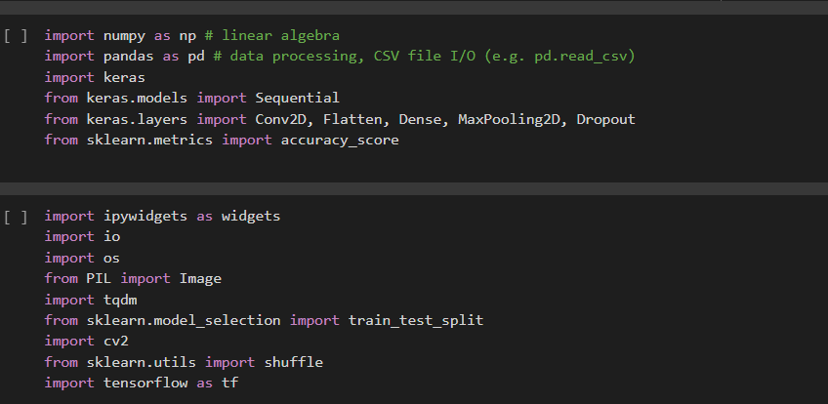
importing Libraries

Slide 15
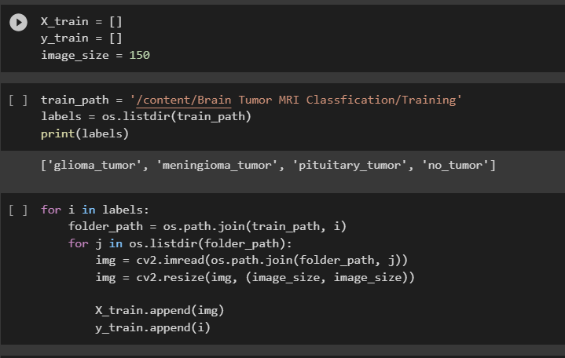
Convert into numpy array

Slide 16
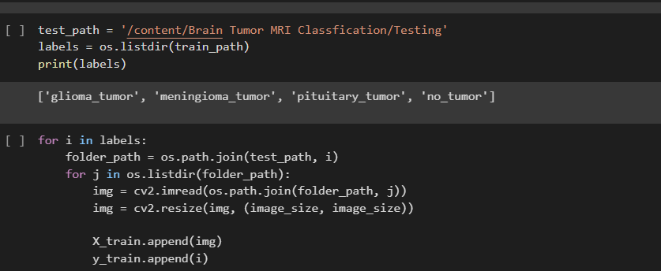
Convert into numpy array

Slide 17
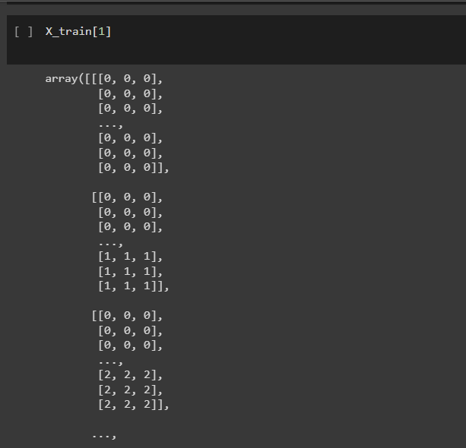
RESULT

Slide 18
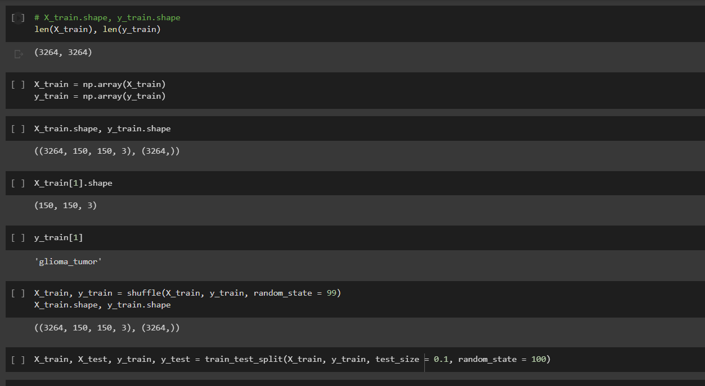
SPLITING

Slide 19
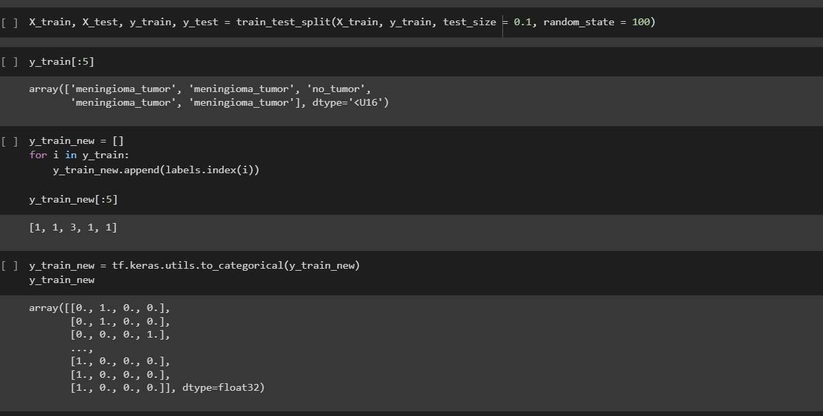
SPLITING

Slide 20
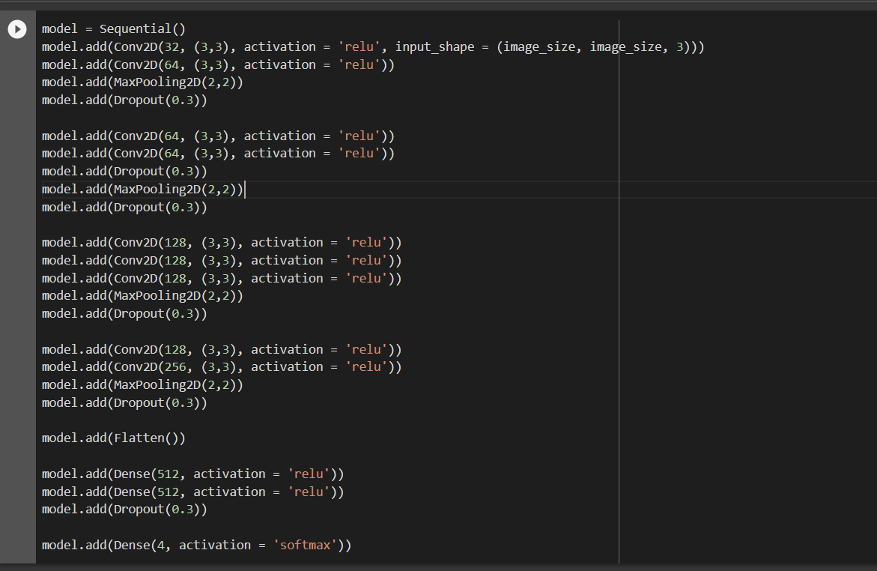
CNN Model

Slide 21
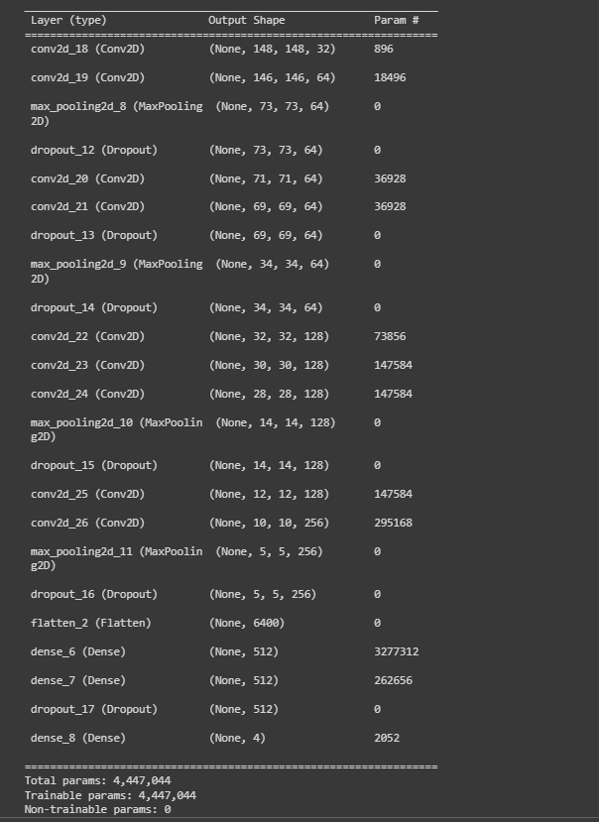

Slide 22
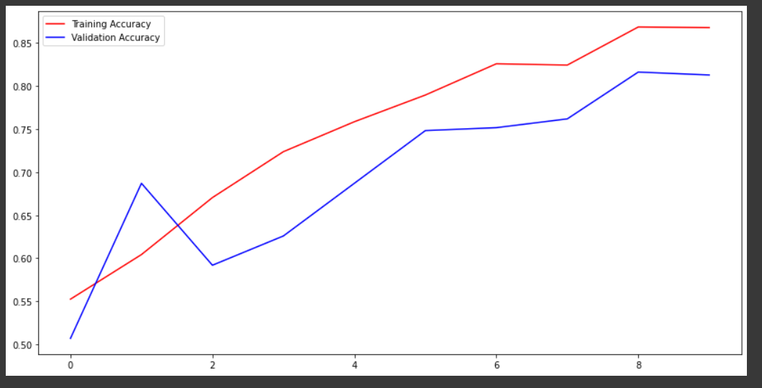
ACCUARACY

Slide 23
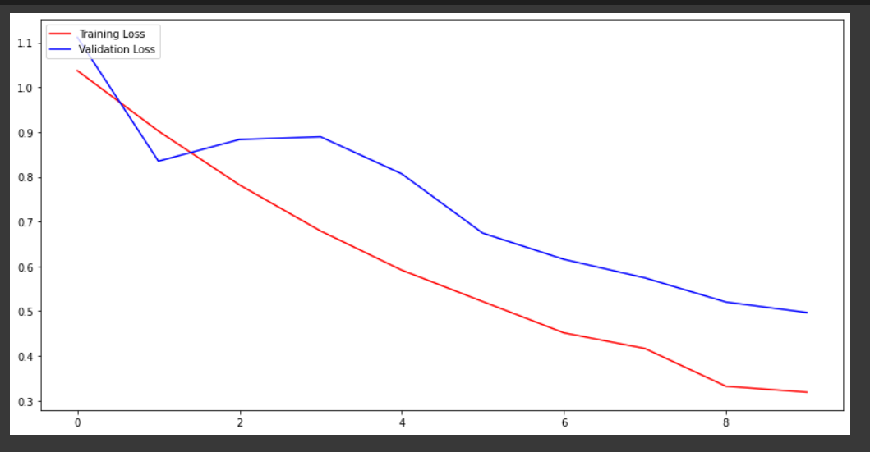
LOSS

Slide 24
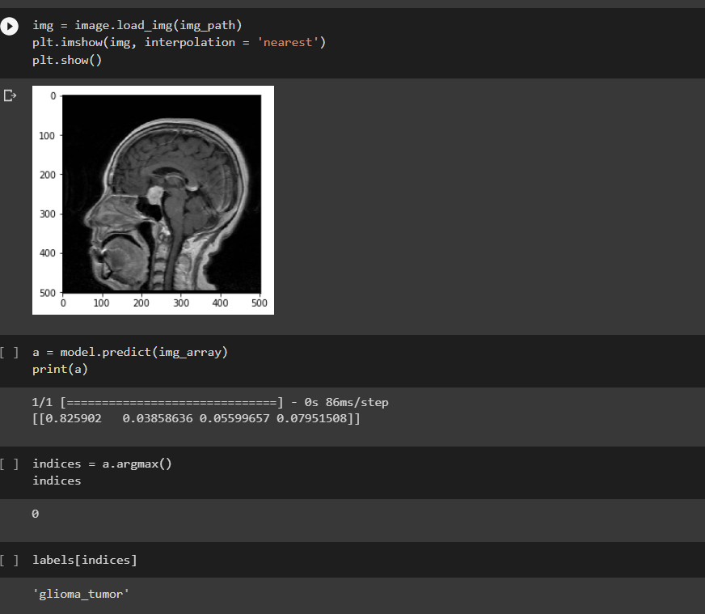
PREDICTION

Slide 25
CONCLUSION

Slide 26
CONCLUSION
CNNs are excellent tools for detecting brain cancers in MRI images. In the 10th epoch, this investigation validation accuracy of 86% and a loss value of 0.3476. The model performance can be improved in the future we have access to additional amount of data and more powerful hardware to handle computations involving such a large amount of data.

